Slide 1
How to identify & Properly report Child abuse
Fall 2017
Margaret M. Ochoa, J.D., Child Sexual Abuse Prevention Specialist
Colorado School Safety Resource Center
Colorado Department of Public Safety

Slide 3
What are you all experiencing when it comes to child abuse and mandated reporting?

Slide 4
The Problem
Signs/symptoms
Reporting
CO4KIDS.ORG

Slide 5
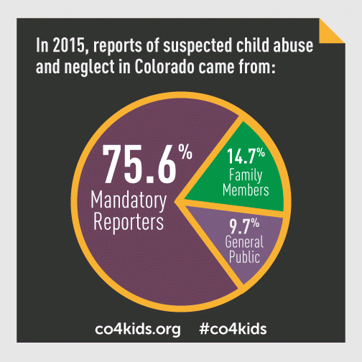
2015
90,700 reports of child abuse or neglect
11,414 substantiated cases
1,000 sexual abuse
1,216 physical abuse
8,863 neglect (159 medical)
335 (psych/emotional)
77.6% of total cases are neglect
31 children experience neglect
or abuse each day

Slide 6
2016
56,637 reports of child abuse or neglect
12,679 substantiated cases
1,067 sexual abuse
1,375 physical abuse
*9,752 neglect (189 medical)
300 (psych/emotional)
*77% of reports were neglect
Notes:
Source CDHS-DCW

Slide 7
Child Abuse Laws
1901
1992
2002
2013
2015
2016
2017
Claire Davis Act and Sexting Legislation
1974
First Federal Law Protecting Animals
Child Abuse Prevention and Treatment Act (CAPTA))
Mandated Reporting
Sex Offender Registry
Child Abuse Reporting Hotline
Erin’s Law
Human Trafficking

Slide 8
Child Abuse—What is it?
Physical
Emotional
Neglect
Sexual

Slide 9
Physical Abuse
Can include bruising, fractures, burns, soft-tissue swelling, even death (Does not include reasonable discipline)
Child’s or parent’s explanation does not comport with injuries
Non-Accidental
Bruising in various stages
Obvious patterns explained away

Slide 10
Neglect 70% of Colorado Cases
Inadequate Supervision
Physical—what care would a reasonable parent give?
Food (malnutrition)
Clothing
Shelter
Medical Attention
Educational

Slide 11
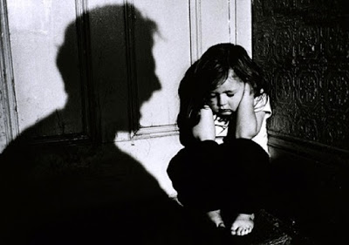
Emotional Abuse
Standard
Impairment of intellectual or psychological functioning, including emotional development or self-worth
Most Difficult to Prove
Cultural/familial norms are different
Some forms are undeniable

Slide 12
Sexual Abuse
Any sexual contact with a child for the gratification of another
There will be physical evidence in only 10% of cases
Exposure
In person, online
Exploitation (to include trafficking)

Slide 13
Overview- Child Sexual Abuse
1 in 5 girls and 1 in 20 boys is a victim of child sexual abuse
Some children are more vulnerable to CSA
Of the children victimized in 2011, 13% had one victimization known to police while 46% had one prior incident known to schools
Source: Crimes Against Children Research Center and David Finkelhor

Slide 14
Trafficking of Students
Happens in all 50 states of the USA
May be sex trafficking or labor trafficking
Pimps are known to prey on victims as young as 9
Recruiting may occur:
via social media, chat-lines
after-school programs
at shopping malls
bus depots
in clubs or
through friends or acquaintances
who recruit students at school
From: Human Trafficking of Children in the United States, A Fact Sheet for Schools, U.S. Department of Education, 2013

Slide 15
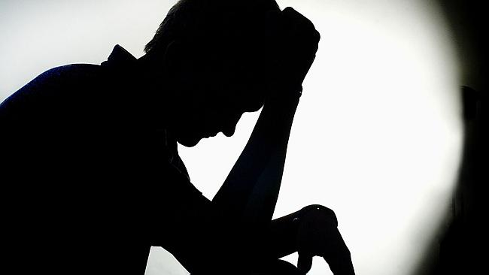
Trafficking
Possible indicators:
Inability to attend school regularly or control documents
Runs away from home
Talks about debts
Exhibits signs of:
trauma
substance use
From: Human Trafficking of Children in the United States, A Fact Sheet for Schools, U.S. Department of Education, 2013

Slide 16
How Does Sexual Abuse Manifest Itself? (Physically, behaviorally, emotionally)
Watch for changes
Bedwetting/Bathroom difficulties
Sexualized behavior (CONTEXT!), evidence of discomfort
Changes in hygiene
Changes in social interactions
Mood changes
Decline in academics

Slide 17
Who Might be Perpetrators of CSA?
Males or females
Heterosexual or homosexual adults
Adults, teens or children
Parents, caregivers, siblings, or peers
All races, ethnic groups and religions
There is no profile of an abuser!

Slide 19
Reasons to Report
Help a Child
Child is at risk
No voice
Criminal Penalties
3rd degree misdemeanor
$750 fine and/or six months in jail
Civil Penalties
Civil damages
Employment/licensure repercussions

Slide 20
Reasons to Report
Immunity
Claire Davis Act

Slide 21
Obligations of Mandatory Reporters
What is a mandatory reporter required to do?
C.R.S. 19-3-304, requires:
Reasonable cause to know or suspect that a child has been subjected to abuse or neglect OR
You observed the child being subjected to circumstances or conditions that would reasonably result in abuse or neglect:
You shall immediately report to the
county department,
the local law enforcement agency, or
the child abuse reporting hotline system
(1-844-CO-4-Kids or 1-844-264-5437)
Notes:
Need to make a call and file a written report to prove you’ve completed your obligations as a mandated reporter.

Slide 22
Your Role
You are a reporter, NOT an investigator
You can support staff in reporting but must report as well if you have your own concerns
Contact the Office of Child Protection Ombudsman with any concerns with response
http://www.protectcoloradochildren.org/
Develop relationships with your local county services personnel

Slide 23
How to Complete a Report
See Colorado Information Gathering and Referral Process in your handouts
What Happens After I Report?
See Hotline Flowchart in your handouts

Slide 24
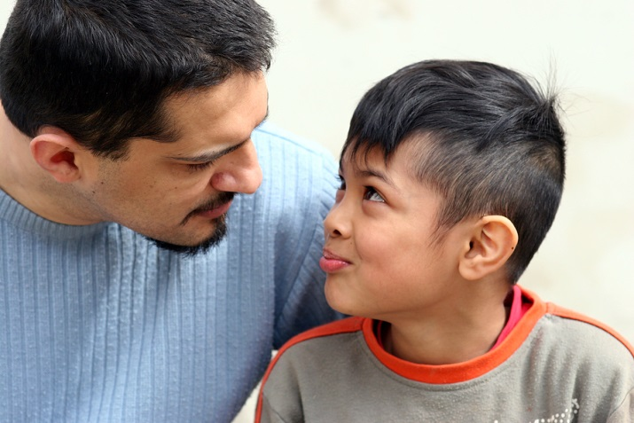
How to Interact with the Child
Believe them!
Provide a safe environment
Reassure the child
Ask open ended questions
Document exact quotes
Make no promises
Discuss why you can’t keep this between the two of you
Source: Health and Human Services Administration

Slide 25
YOUR Job After a Report
Provide safety and security
Create structure and consistency
Identify strengths and talents
Support other staff as needed
Share resources with parents on how best to support their child

Slide 26
Scenarios
Alyssa loves to take care of other children. You have noticed that she always seems especially concerned about her three younger siblings. Today you caught her stuffing extra snacks in her backpack. She said she needed to take it home for her brothers and sisters.
Katherine, age 11, is having a hard time walking. When she sits down, she acts like it hurts. You ask her what is wrong. She just looks down and says, “Nothing.” A few days later, she is playing soccer with the other children. You notice dark purple bruises on her inner thighs. She says she fell off her bike.

Slide 27
Scenarios
3. Your colleague, a music teacher, meets with students in a room with no window. She closes the door to improve acoustics. The students stand in a line front to back to give one another shoulder massages during vocal warm ups.
Maddie, 15, is in foster care. She dates a boy that graduated last year. She seems exhausted all the time and frequently falls asleep in class because she works a lot. She has a new iPhone, but frequently talks about her debts.

Slide 28
Additional Resources
Mandated Reporter
And Trafficking Training
CSSRC Website
Colorado Children’s
Alliance
coloradocwts.com
colorado.gov/cssrc
coloradocac.org/

Slide 29
Thank you for your time and all that you do for youth!
Please contact me if the Center can be of service to your school or community.
margaret.ochoa@state.co.us
Tel: 303.239.4439

